Slide 1
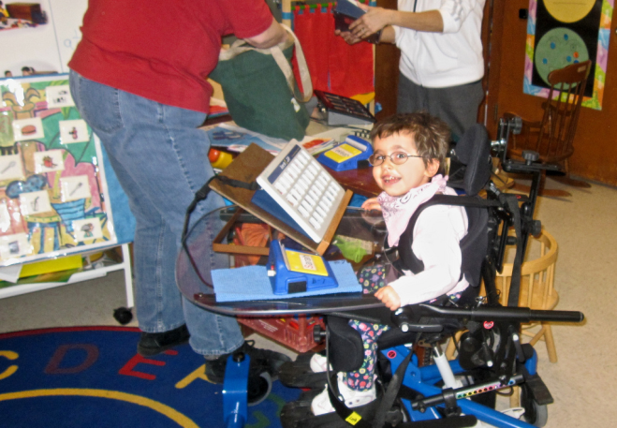
Towards full digital inclusion
Evert-Jan Hoogerwerf

Slide 2
Evert-Jan Hoogerwerf Affiliations
Head of Sector Projects &Innovation
AIAS BOLOGNA Onlus
Emilia Romagna’s Regional Centre for Assistive Technology
Independent Assistive Tecnology Centre in Bologna, Italy
www.ausilioteca.org Mail: hoogerwerf@ausilioteca.org
Past President and project manager
ASSOCIATION FOR THE ADVANCEMENT OF ASSISTIVE TECHNOLOGY IN EUROPE
Sector organisation
Members in 24 countries. Office: Linz Austria
www.aaate.net Mail: hoogerwerf@aaate.net

Slide 4
Digital inclusion Bridging the digital divide
Access to employment and education
More fulfilled lives
More freedom and choice
Access to rights
Wider participation in society

Slide 5
Looking forward Policy drivers
European Union legislation and policy programmes
Full implementation of the UNCRPD
The UN 2030 Agenda for Sustainable Development
WHO, ITU, UNESCO reports highlighting the enabling role of technology

Slide 6
Internet use
Households in Europe with access to the Internet
2015: 83%
2006: 50%
Source: Eurostat. Digital economy and society statistics - households and individuals. http://ec.europa.eu/eurostat
Internet use and non-use by disability status, 2014 to 2016, UK
Source: Office for National Statistics (UK)

Slide 7
Reducing the digital divide together
Supporting the development of digital skills of
persons with disabilities of all ages
Policies, strategies and tools
www.entelis.net
Study into
Opportunities and Barriers
to full digital inclusion
Literature review
Assessment project outcomes
Direct investigation involving stakeholders (surveys, interviews)
Living labs

Slide 8
Barriers to full digital inclusion - Society
Level | Area of interest | Barriers
Societal | Politics and policy | Lack of an inclusive mainstream approach at all policy levels and in many policy fields. Lack of collaboration and coordination among public institutions. Lack of innovative approaches encouraging independence (e.g. commissioning structures that pay based on what is ‘wrong’ with people and not on personal objectives). Insufficient or inadequate legislation (e.g. web/media accessibility). Failure of existing legislation to effectively cover essential aspects of ICT/ICT-AT for PwD. Lack of policy to systematically address the digital divide with adequate resources. Lack of priority given to ICT-AT education in the national disability and rehabilitation agenda.
 | Culture | Society, including media, often reproduces a stereotyped view of disability. Prevalence in social and educational settings in many countries of the deficit model of disability, discouraging ICT-AT effective use. Terminology incompatibilities and discrepancy in awareness and proficiency levels in relation to ICT/ICT-AT policy and practice.
 | Usability and accessibility | Inaccessibility of mainstream technology. Complex and challenging interfaces and user experience. Lack of awareness and understanding of PwD’s needs among product designers and developers. Lack of interoperability between technologies.
 | Financial, economic | The unavailability of specific devices on national markets. The cost of the technology for the end user and/or for the provider, especially where public funding is not sufficient. Limitations in the provision of additional resources (e.g. training, add-ons, etc.) Lack of facilitating resources (e.g. equipped computer labs).

Slide 9
Barriers to full digital inclusion - Community
Level | Area of interest | Barriers
Community | Competence/ guidance/ education | Lack of general awareness on the opportunities offered by technology for activities and participation of people with disabilities. Ineffective information management and organisation of the information among information holders and authorities. Lack of competence in helping people assessing their needs and matching the needs with the available solutions. Lack of user-centred and user-driven approaches. Lack of ICT & ICT-AT competencies and confidence to use technology among professionals, including teachers and educators. Uncertainty about how to use it and to train others in using it. Lack of sufficient user training and appropriate personal support. Educational systems are not fully prepared to support learners with disabilities in developing their ICT and ICT-AT skills.
 | Services and support | Lack of independent advice and knowledge centres. Lack of AT specialists in rehabilitation teams. Lack of interagency collaboration. Lack of openness to innovation among service providers. Lack of teamwork among professionals and with the user and his or her informal carers. Poor timing of interventions (e.g. too late, too early, too slow). Insufficient administration with difficulties in procuring and managing equipment and services Inconsistency in the follow-up of technology acquisition. Lack of support over time.

Slide 10
Barriers to full digital inclusion - Person
Level | Area of interest | Barriers
Personal | Personal motivation | Low self confidence. Technology perceived as not useful and not responding to actual needs. Alternative strategies to avoid use of technology. No time in daily routine. Fear that technology use might reduce human care or contact.
 | Security benefits and challenges | Risks related to safe internet use. Risks related to personal data treatment. Fear of losing control over technology.
 | Health condition | Objective activity limitations (e.g. dementia).

Slide 11
High level objectives

Slide 12
A very simple roadmap

Slide 13
Digital inclusion roadmap

Slide 14
Education
Roadmap Objectives-Needs-Recommendations
Phase | Objectives | Needs | Recommendations
Assessment | Assessment of the whole educational environment and identification of areas of improvement. Goal setting. | Standards for the assessment of the performance of education providers in the area of ICT and ICT-AT support to learners with disabilities. Time and resources to perform an objective and complete assessment. Vision based decisions regarding reachable goals and priorities. | Standards and assessment tools should take the whole school environment into account, including the declared mission, the educational culture and the relationships established with other stakeholders in education, such as families, further education, transition to employment etc.
Development & Innovation | Development and delivery of training for staff and management as well as for end users. | ICT-AT initial education of teachers and other school staff, as well as lifelong learning opportunities and obligations. Qualified staff to support learners with disabilities in developing digital skills. Curricula and competence frameworks to direct learning. Assessment strategies of the learned. Learning opportunities in AT for family members and informal carers. | Trainers, teachers and educators at all levels and in all types and levels of education should have sufficient competencies and skills to support learners with disabilities in making the best possible use of ICT and ICT-AT for learning and for their effective functioning and participation in the digital society. Generally speaking more opportunities for ICT-AT training should be created and offered, respectful of learning needs and preferences of each learner and taking into account the specificity of the individual (e.g. age, condition, etc.).
 | Development of a truly person centred approach enhancing skills, participation and independence. | Individualised learning plans and pathways including appropriate assessment strategies and tools and adequate use of digital technologies for learning and personal AT equipment, if needed. Educational strategies and implementation plans for increasing the use of AT in and outside the classroom. Opportunities for the independent assessment of AT needs of the single students and regular reviews. | Schools should fully embrace an inclusive approach based on the recognition of the needs of each single learner. Schools should transfer (digital) skills to ensure people with disabilities can meaningfully participate in all realms of life. Therefore tailor-made support should be provided to enable all people with disabilities to ensure learning and participation. Ensuring self-empowerment is the key to create opportunities for full inclusion. Schools serving different age groups should collaborate in the transition of students with disabilities from one institute to another or out of education into employment and collaborate with the families in providing continuity in the digital skills development of the student, including in the selection and use of appropriate assistive technologies that can be used in all life environments, including meaningful employment. Supporting experts in education (e.g. speech and language therapists, psychologists, pedagogists, etc.) should be included in the assessment of needs and consulted when needed.
 | Implementation and management of change where needed, including communication and attitude change. | Action plans to implement change, with adequate timing, resources and monitoring strategies. | Where schools do not have the resources internally, external support should be sought in the form of specialised professionals in AT and multidisciplinary teams for the selection and implementation of AT as well as for educating and training staff.
Consolidation | Ongoing monitoring and regular assessment of individual and sector outcomes (e.g. competences, transitions). | Performance indicators for single schools as well as for the entire sector. ICT-AT competence assessment and certification programmes for learners with disabilities. | Educational authorities and school directions should regularly monitor outcomes and adjust policies and practices where needed. To motivate learners, to consolidate learning outcomes and to make ICT-AT competences visible, standardised certification schemes and tools should be developed and implemented.
Standards and performance indicators
LLL professional development
Individualised learning plans
Change management
Competence frameworks & certifications

Slide 15
Social sector
Roadmap Objectives-Needs-Recommendations
Phase | Objectives | Needs | Recommendations
Assessment | Assessment with clients of ICT opportunities. | Assessment strategies to match the person with the technology. | Assessments should be part of a wider person centred approach, establishing goals related to independence and pathways to reach those goals (including the role of support actors and assistive technology). Assistive technology assessments should start as early as possible and should be repeated as necessary.
 | Assessment whole service environment. Goal setting. | Standards for the assessment of the whole service environment. Time and resources to perform an objective and complete assessment, including cost benefit analysis related to the use or non-use of technology to empower service uses. Vision based decisions regarding reachable goals and priorities, taking into account different scenarios and available financial resources. Where needed ensuring additional resources for long term sector innovation. | The social care sector should assess its functioning and level of digitalisation compared to other sectors of the economy and where there are no impediments, adopt technological solutions for reaching the same or higher goals in terms of efficiency, but also quality of life of the assisted. Standards should take the whole social care environment into account, including the declared mission, the goals of care, the culture of care and the relationships established with other stakeholders, such as families, employment services, adult education, etc. Assessments of these standards should take into account the available economic resources.
Development & Innovation | Development and delivery of training for staff and management as well as end users. | Digital skills as part of the initial education of workers in the care sector, as well as lifelong learning opportunities and obligations. Qualified staff to support clients with disabilities in using personal ICT equipment and in developing digital skills. Opportunities for family members and carers to get familiar with the use of AT. | Care workers should have basic ICT skills and be aware of the importance of ICT and ICT-AT for the people they support. In each service there should be staff able to support clients in their ICT-AT use. The important role of family members and care workers in the effective use of ICT-AT and in the prevention of its abandonment should not be overlooked.
 | Development of a truly person centred approach enhancing skills, participation and independence. | Individualised plans and pathways aiming at empowerment, independence, independent living and de-institutionalisation. Development of models of specialised ICT and ICT-AT service delivery to end users and other stakeholders (e.g. independent assistive technology centres). | The social care sector should find the right balance between human care and technology supported care, aiming at different but non incompatible goals: quality jobs, humanised care, personalised care solutions, care on demand. Persons with disabilities and older service users should be involved in designing and evaluating user-centered AT services.
 | Implementation and management of change where needed, including communication and attitude change. | Action plans to implement change, with adequate timing, resources and monitoring strategies. | Developments in ICT towards ubiquity, personalisation, singularisation and digitisation will impact on the type and the way services are designed, delivered and evaluated. These opportunities will have to be embedded into service infrastructures. Services will be different and need new skills, new partnership and management structures, in particular when reaching out beyond traditional organisations into mainstream. Where social care providers do not have the resources internally, external support should be sought in the form of specialised professionals in ICT and ICT-AT and multidisciplinary teams for the selection and implementation of AT as well as for educating and training of staff.
Consolidation | Ongoing monitoring of results in terms of quality of life, cost-benefits and service efficiency. | Performance indicators for the sector as well as for single care providers. Tools for outcome measurement in terms of cost-benefit analysis, client and staff satisfaction, quality of life. | Only by demonstrating outcomes the social care sector will be able to become a driver of the digital economy. Organisations in the social care sector should become role models of ICT and ICT-AT driven inclusion reaching out into all domains of society.
Assessment strategies - individual - environment
Goal setting - vision - sector innovation
LLL professional development
Individualised pathways - deinstitutionalisation
Change management
Performance indicators - outcome measurement

Slide 16
Technology
Roadmap Objectives-Needs-Recommendations
Phase | Objectives | Needs | Recommendations
Assessment | Assessment of barriers and reporting of inaccessibility where it occurs at all levels and in all places (including media). | Multilingual tools and information channels for the reporting of inaccessible digital environments, products and services. Dialogue with industry to impact on the design of new technologies, making these as accessible as possible. | Both guidelines for web accessibility and monitoring tools are available and in some countries they are used on a permanent basis to assess web accessibility (e.g. the Netherlands). Other countries should follow.
Development & Innovation | Promotion of universal and user centred design and of accessible mainstream products and services. | Information and awareness regarding universal design and accessibility issues towards industry and the trainers of designers and developers. | Designers of products and services should systematically take human/user-centred design guidelines into account. Different guidelines are available and easy to find on the Internet.
 | Promotion of the development, testing and diffusion of innovative technological solutions. | Feeding the innovation cycle with good and bad user experiences and with information on missing solutions, products and services. Political support to research and development programs in this field. | Unsolved issues regarding the accessibility of digital environments should be solved by creative innovation driven communities of users and developers. Individual needs should be recorded and used to define requirements that can impact on the accessibility and usability of future ICT systems with or without AT. Human-Machine Interaction (HMI) should be intuitive and interfaces should adapt to the person’s needs and preferences. More attention to the whole user experience is needed in the design and development stage of products and services.
 | Promotion of interoperability standards. | Awareness raising regarding interoperability issues among developers of hard and software solutions. | Interoperability standards exist and should be taken into account in all cases.
Consolidation | Supporting the market uptake of innovative inclusive digital solutions for activity and participation of all. | Increased efforts to disseminate knowledge about existing solutions and the conditions for successful use. The creation of independent knowledge hubs to support people with disabilities to choose the most appropriate solutions for their needs and wishes.
Reporting tools inaccessible digital environments
Dialogue with industry
Awareness raising towards designers
Feeding the innovation cycle with needs
Awareness raising re interoperability issues
Independent knowledge hubs and AT centres

Slide 17
Policy
Roadmap Objectives-Needs-Recommendations
Phase | Objectives | Needs | Recommendations
Assessment | Assessment of gaps and barriers in legal and policy frameworks. Collection of good practice and data. Reporting. | Regular monitoring of the implementation of the UN Convention, in particular the articles related to universal design, accessibility and assistive technology. Collection of data on participation of people with disabilities in different sectors of public life and of the economy. Assessment strategies to trace the type of barriers to inclusion in different sectors and the potential role of (assistive) enabling technology to enhance inclusion. The systematic collection of outcomes and outcome studies related to policies in a certain area. Constant monitoring of the alignment of policies and laws with the UN Convention and with the digital inclusion agenda. | Governments have a key role in driving the inclusive digital agenda. Without high level support for digital inclusion and adequate policy frameworks, a lot of efforts will result in little effect. Assessment strategies will have to be defined that take into account differences between countries and regions, both in level of inclusiveness of policies and services, as well as in technological development of mainstream society.
Development & Innovation | Development of policies, sector level strategies, implementation plans, monitoring tools | Awareness raising among policy makers. Legitimisation of ICT-AT training in education and supported employment settings. Alliances with other stakeholder organisations at European, national, regional and local level. Structural collaboration with disabled people’s organisations. Supportive governments, at all levels, particular national government and at a regional level, to help mainstream ICT-AT aided participation of people with disabilities in all realms of life and to develop appropriate strategies, implementation plans and monitoring tools. Advocacy for more appropriate funding schemes for Assistive Technology. | People with disabilities should be actively involved in all decisions regarding them. A core aim of technology adoption should be independence and allowing people to have choice. A comprehensive strategy to bridge the digital divide is needed for all countries and for all administrative levels, taking into account and combatting the different barriers, and investing in the empowerment of people. The strategies should involve organisations with a different focus: policy, education, welfare, employment, technology, research, digital economy, advocacy. Governing bodies (e.g. Ministries of Education, Ministries of Telecommunication, etc.) and local administrators should take the lead and coordinate appropriate action plans, allowing different actors to integrate their contributions to the strategies. Priority should be given to employment as paid and meaningful employment will increase people’s wider inclusion in society.
Consolidation | Ongoing alignment of policies with changing global social, technological and educational scenarios. | Ongoing monitoring of the impact of technological development on the digital divide and the inclusive society. | Inclusiveness should be the touchstone for all policies and inspire all policy assessment frameworks.
Regular monitoring of UNCRPD implementation
Collection of outcome studies - evidence
Awareness rasing among policy makers
More appropriate funding schemes for AT
Alliances with stakeholders at all levels
Monitoring impact ICT development on DD

Slide 18
Easy to understand Summary
Ireland is surrounded by sea
Always keep the wider picture.
My work is important!
The importance of having a
framework for action

Slide 19
There is a big fish out there and it is called: «digital inclusion»
Let’s get out and catch it!

Slide 20
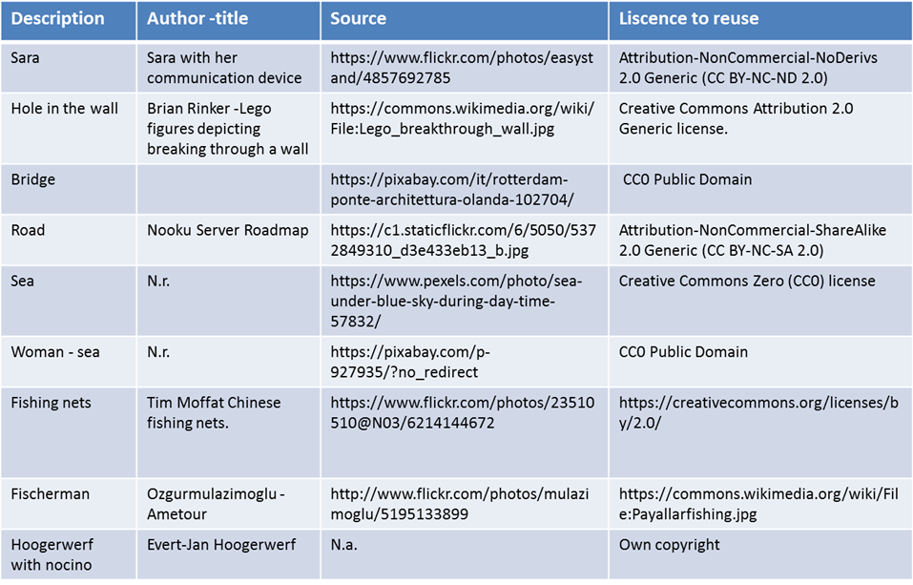
Thank you!
hoogerwerf@ausilioteca.org
Main reference: Hoogerwerf et. al. (2016). Digital inclusion. A white paper. www.entelis.net
Pictures

